Slide 1
Concurrency Part II:
Process Deadlock and Starvation
Supplemental material for CS 3100, Chapter 7

Slide 2
What is Deadlock?
Permanent blocking of a set of processes that either compete for system resources or communicate with each other
Involves conflicting needs for resources by two or more processes
There is No single effective strategy to deal with deadlock!

Slide 3
Bridge Crossing Example
Traffic only in one direction.
Each section of a bridge can be viewed as a resource. Starvation is possible.
A proactive approach would be Deadlock Prevention (to NEVER let this happen) or Deadlock Avoidance (TRY to avoid this situation).
If a deadlock occurs, it can be resolved if one car backs up (preempt resources and rollback). This is known as Deadlock Detection (after the fact).
NOTE: One solution is not better than another, and each comes with a price.

Slide 4
Reusable Resources
Used by only one process at a time and is not depleted by that use
Processes obtain resources that they later release for reuse by other processes
Examples: Processors, I/O channels, main and secondary memory, files, databases, and semaphores
Deadlock occurs if each process holds one reusable resource while requesting another

Slide 5
Example of Deadlock (Reusable)
Space is available for allocation of 200K bytes, and the following sequence of events occur
Deadlock occurs if both processes progress to their second request
P1
P2
. . .
. . .
Request 80K bytes;
Request 70K bytes;
. . .
. . .
Request 60K bytes;
Request 80K bytes;

Slide 6
Consumable Resources
Created (produced) and destroyed (consumed) by a process
Examples: Interrupts, signals, messages, and information in I/O buffers
Deadlock may occur if a Receive message is blocking
May take a rare combination of events to cause deadlock

Slide 7
Example of Deadlock (Consumable)
A process attempts to receive a message from the other process and then send a message to the other process.
Deadlock occurs if the receiving process is blocked.
P1
P2
. . .
. . .
Receive (P2);
Receive (P1);
. . .
. . .
Send (P2, M1);
Send (P1, M2);

Slide 8
3 Conditions for Deadlock…
Mutual exclusion
  A process has exclusive access to a sharable resource.
Hold-and-wait
  A process is holding a sharable resource, and is waiting for a resource held by another.
No Preemption
  If a process requests a resource currently held by another process, the operating system (or another process) may not preempt the second process and require it to release its resources.
All three lead to a fourth condition….

Slide 9
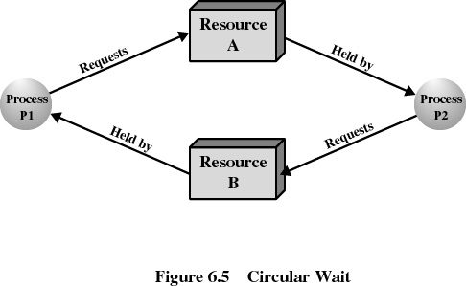
…Define Deadlock
Circular wait
  Prevented by defining a linear (not circular) ordering of resource types

Slide 10
Resource-Allocation Graph
A set of vertices V and a set of edges E.
V is partitioned into two types:
  P = {P₁, P₂, …, P_{n}}, the set consisting of all the processes in the system.
  R = {R₁, R₂, …, R_{m}}, the set consisting of all resource types in the system.
Request edge – directed edge P_{i} → R_{j}
Assignment edge – directed edge R_{j} → P_{i}

Slide 11
Resource-Allocation Graph (cont)
Process
Resource type with 4 instances
P_{i} requests instance of R_{j}
P_{i} is holding a single instance of R_{j}
P_{i}
R_{j}
P_{i}
R_{j}

Slide 12
Basic Facts
If graph contains no cycles ⇒ no deadlock.
If graph contains a cycle ⇒
  And, if only one instance per resource type, then deadlock.
  And if several instances per resource type, possibility of deadlock.

Slide 13
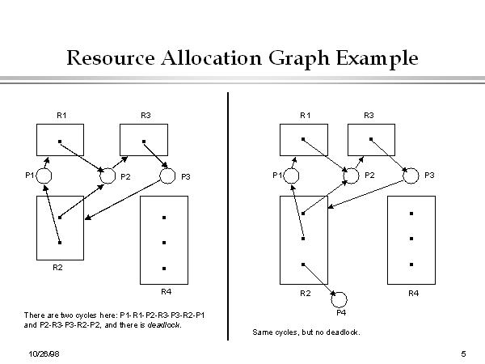
Resource Allocation Example

Slide 14
Methods for Handling Deadlocks
Ensure that the system never enters a deadlock state (Prevention).
Ignore the problem and pretend that deadlocks never occur in the system; used by most operating systems, including UNIX (Avoidance).
Allow the system to enter a deadlock state and then recover (Detection); used by Windows.

Slide 15
Two Approaches to Deadlock PREVENTION
Indirect: Prevent the occurrence of one of the three (Mutual Exclusion, Hold and Wait, or No Preemption) necessary conditions.
Direct: Prevent the occurrence of Circular Wait.

Slide 16
Indirect Deadlock Prevention
Restrain one of the ways request can be made.
Mutual Exclusion – is not required for sharable resources (i.e.: read only files), but must hold for non-sharable resources (i.e.: printer).
  Remember, Synchronization requires M.E.
Hold and Wait – must guarantee that whenever a process requests a resource, it does not hold any other resources.
  We could require process to request and be allocated all its resources before it begins execution, or allow process to request additional resources only when it releases and goes back to “none”.
  BUT…results in low resource utilization; starvation possible.
Notes:
In general, it is not possible to prevent deadlocks by denying the mutual
exclusion condition; some resources are intrinsically nonsharable.

Slide 17
Indirect Deadlock Prevention (cont)
No Preemption –
  If a process is holding some resources and requests another resource that cannot be immediately allocated to it, then all resources currently being held are released.
  Preempted resources are added to the list of resources for which the process is waiting.
  Process is restarted only when it can regain its old resources, as well as the new ones requested.
  Good for resources that can easily save context, but not easy for resources like printers or I/O drives.

Slide 18
Direct Deadlock Prevention
Circular Wait – impose a total ordering of all resource types, and require that each process requests resources in an increasing order of enumeration.
  This defeats the purpose of scheduling.

Slide 19
Deadlock Avoidance
A decision is made dynamically whether the current resource allocation request will, if granted, potentially lead to a deadlock
Requires knowledge of future process requests.

Slide 20
Two Approaches to
Deadlock Avoidance
Do not start a process if its demands might lead to deadlock.
Do not grant an incremental (additional) resource request to a process if this allocation might lead to deadlock.

Slide 21
Process Initiation Denial
A process is only started if the maximum claim of all current processes PLUS those of the new process can be met.
Not an optimal strategy because it assumes the worst – that all processes will make their maximum claims together.

Slide 22
Resource Allocation Denial
Referred to as the Banker’s Algorithm
State of the system is the current allocation of resources to processes
Safe state is where there is at least one sequence that does not result in deadlock
Unsafe state is a state that is not safe and may lead to deadlock.

Slide 23
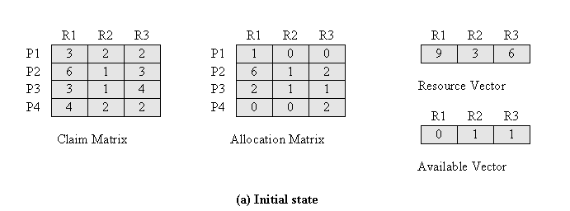
Determination of a Safe State
Initial State
Notes:
Resource Vector: How many units of each resource are available on the system.
Allocation Matrix: Snapshot of what’s Currently allocated to the processes on the system.
Available Vector: Resource Vector – Total Allocation Matrix (Column Totals).
Claim Matrix: What’s being requested by the processes.

Slide 24
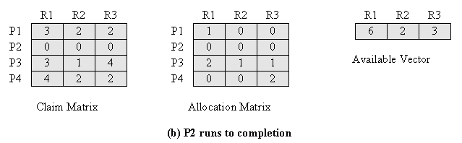
Determination of a Safe State
P2 Runs to Completion
Notes:
Based on last slide, P2 only needs 1 R3 to run to completion. We had 1 R3 available in our available vector. So, P2 can “safely” be allocated 1 unit of R3, which allows it to run to completion (and consequently release ALL its resources – R1, R2, and R3), back into the Available (System) Vector.

Slide 25
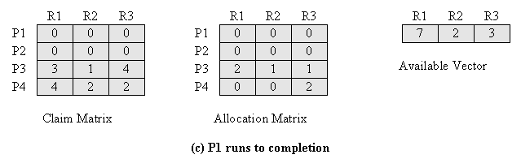
Determination of a Safe State
P1 Runs to Completion
Notes:
We do the same thing with the remaining processes.

Slide 26
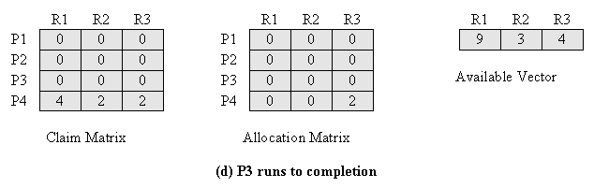
Determination of a Safe State
P3 Runs to Completion
Notes:
The main question to answer whether the system is in a safe state is “Can ALL the processes run to completion?” Based on the initial claim matrix, the answer is “YES”.

Slide 27
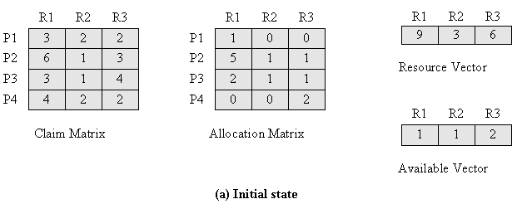
Determination of an
Unsafe State
Notes:
In this example: To Run P1, we need 2, 2, 2.
To Run P2, we need 1, 0, 2.
To Run P3, we need 1, 0, 3.
To Run P4, we need 4, 2, 0.
If the claim matrix does not change, We can run P2, based on availability, and continue.
HOWEVER, What if P1 and P3 have to run to completion BEFORE P2? (Next Slide)

Slide 28
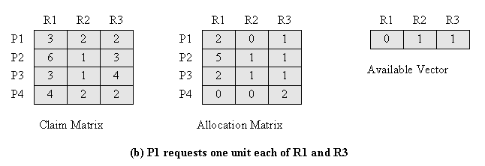
Determination of an
Unsafe State
Notes:
Since P1 requests first (1 R1 and 1 R3), and we give it to it, then we don’t have any available R1 resources to give ANY of the remaining processes. Since NONE of the processes can run to completion (without R1)…it’s an unsafe state (not necessarily deadlock), but the potential strongly exists….
Instead we could regroup…and release 1 R1 and 1 R3 from P1. Then run P2 to completion….etc….

Slide 29
Review: Deadlock Avoidance
Maximum resource requirement must be stated in advance
Processes under consideration must be independent; no synchronization requirements
There must be a fixed number of resources to allocate
No process may exit while holding resources
An unsafe state does not necessarily mean deadlock.

Slide 30
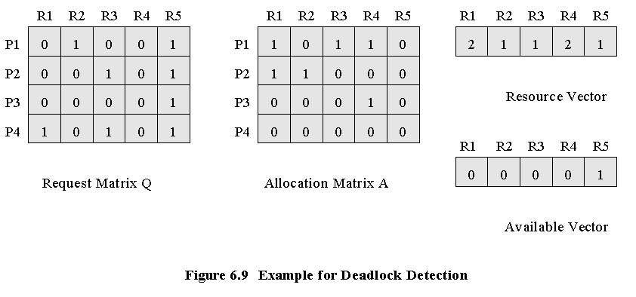
Deadlock Detection
Notes:
Identify the LOWEST (LAST) allocated process with no resources allocated. In the Example P4.
Set Temporary Wait Variable (W) = to available vector. In example W= 0 0 0 0 1
GO UP THE CHAIN, and Find a process REQUEST <= to W.
If found, add values, move up the chain, and repeat process.
Continue until <= no longer exists. If you don’t make it to the top, then a deadlock exists.
Example: W = 00001
Request of P3 = 00001
P3’s request is less than or equal to 00001.
So, now, add P3 ALLOCATION to W, so W now = 00010 + 00001. W=00011.
Move up the chain.
Is P2 REQUEST (00101) <= 00011? No.
Is P1 REQUEST (01001) <= 00011? No.
Conclusion: P1 and P2 are deadlocked.

Slide 31
Strategies once Deadlock Detected
Abort all deadlocked processes
Back up each deadlocked process to some previously defined checkpoint, and restart all process
  original deadlock may occur
Successively abort deadlocked processes until deadlock no longer exists
Successively preempt resources until deadlock no longer exists

Slide 32
Selection Criteria for Deadlocked Processes
Least amount of processor time consumed so far
Least number of lines of output produced so far
Most estimated time remaining
Least total resources allocated so far
Lowest priority

